Slide 1
Exploration of novel deep learning methods for Edge Detection
Group 2: Yifan Gao, Rajat Nagar

Slide 2
Problem Statement Explore Deep Learning methods for detecting edges in images and compare their performance

Slide 3
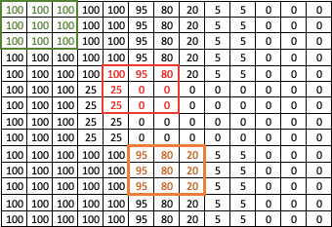
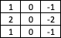
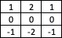
Edge Detection – Concept
Edge Detection aims to find regions in an image where there is a sharp change in intensity or color
Green Area
Horizontal Value = 0
Vertical Value = 0
Horizontal Sobel Filter
Red Area
Horizontal Value = 95
Vertical Value =345
Vertical Sobel Filter
Orange Area
Horizontal Value = 300
Vertical Value = 0
Filtering
Reduce Noise
Enhancement
Find pixels where intensity changes
Detection
Find strong edges through thresholds
Notes:
Concept of edge detection & Traditional Approaches
Hypothesis / Assumptions

Slide 4
Exploratory Data Analysis
The training folder has 300 base images. From there, several augmentation techniques are applied to amplify the dataset, such as cropping, shear, flipping, rotation, resizing, etc.
96 subfolders are created with different variations from base images, making the total number of images in the training to 28800.
The test folder has 200 images.
The labels are ground truth sketches drawn by humans. There are 28800 labels for the training dataset and 200 labels for the test dataset.
Notes:
Split 80% between train and validation
Label is not 0/1 or classification; it’s the sketches drawn by humans

Slide 5
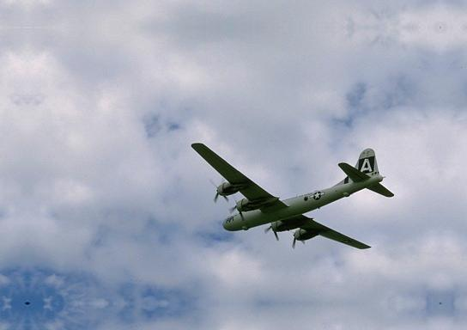

Ground Truth Examples
Notes:
Biggest assumption is that sketches are good representation of the actual

Slide 6
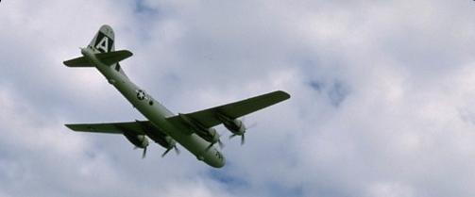
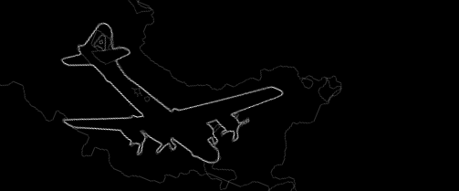
Ground Truth Examples
Notes:
- 2-3 Examples of Actual and corresponding Ground Truth Images

Slide 7
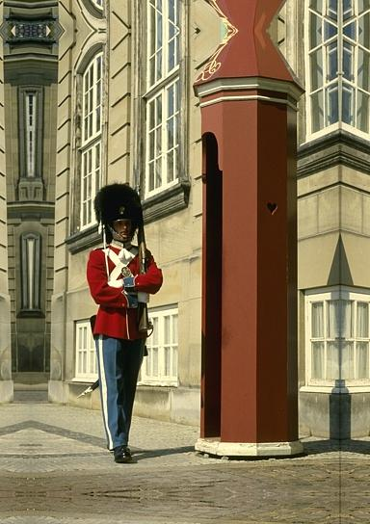

Ground Truth Examples
Notes:
- 2-3 Examples of Actual and corresponding Ground Truth Images

Slide 8
Feature Engineering & Transformations
IMAGES: 3d numpy array
For each image, we normalize the input, by subtracting it by the mean of dataset images, which is a vector of three elements
Then we transpose that to channel x height x width from height x width x channel
LABELS (GROUND TRUTHS): 2d numpy array
Add a new dimension so that it becomes 3d numpy array
Apply mask on labels such that
If element value/pixel is 0, label is 0
If element value/pixel is greater than or equal to eta, a global parameter, label is 1
Else element value/pixel is 2
The training dataset is already augmented when downloading; here we augment the test dataset by resizing it with 0.5 and 1.5 multiplier on each image
Notes:
- BSDS dataset

Slide 9
Model Performance Measurement
In edge detection world, there are two industry standard metrics to measure model performance. The first one is referred as optimal dataset scale (ODS) which employs a fixed threshold for all images in a dataset.
The second is called optimal image scale (OIS) which selects an optimal threshold for each image.
For the two metrics, the higher the better.
Notes:
- BSDS dataset

Slide 10
Model: Enhanced Richer Convolutional Features (ERCF) For Edge Detection

Slide 11
Model Overview
RCF encapsulates all convolutional features into more discriminative representation, which makes good usage of rich feature hierarchies, and is amenable to training via backpropagation.
RCF fully exploits multiscale and multilevel information of objects to perform the image-to-image prediction holistically.
The backbone of RCF model is VGG network, which makes the model easy to understand.
Notes:
- BSDS dataset

Slide 12
Model Design
We try a few different things to improve model performance, but they didn’t work well.
Optimizers: Adam; RMSprop
Batch normalization
Dropout
Parameter tuning: batch size; LR momentum; LR gamma
What works well/Enhancement model?
Learn rate tuning
Backbone model changed to VGG19
Revised cross entropy loss function: tuned eta and lambda parameters
Activation function changed to LeakyRELU
Notes:
- BSDS dataset

Slide 13
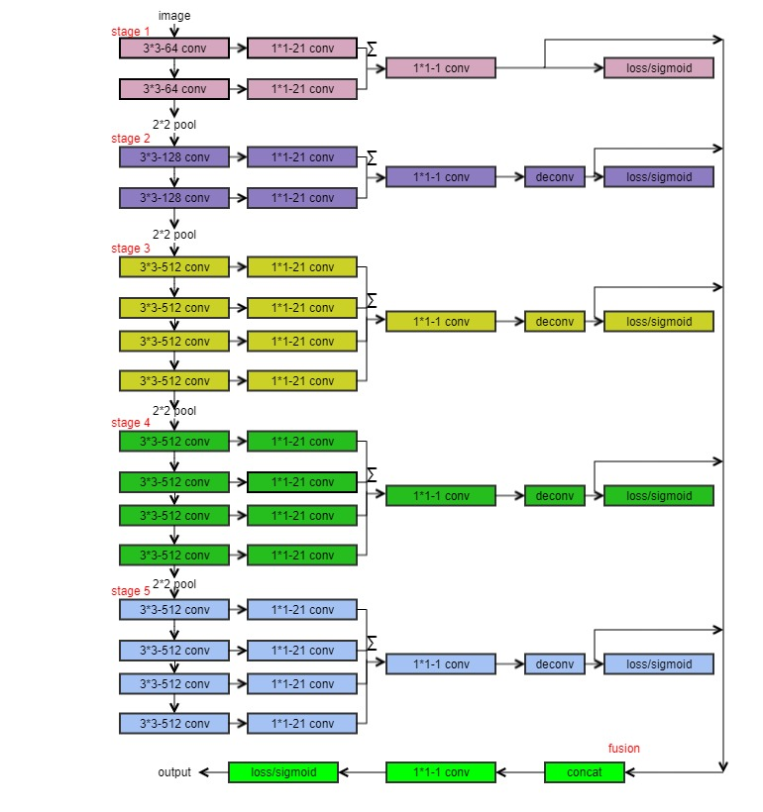
Model Design
Notes:
Backbone is vgg19;
- Input is an image, output is the sketch that combines five images
Deconv layer is used to upsample the image with bilinear interpolation technique
Did not use any regularization technique because performance was not good; also we do not detect overfitting problem in the model

Slide 14
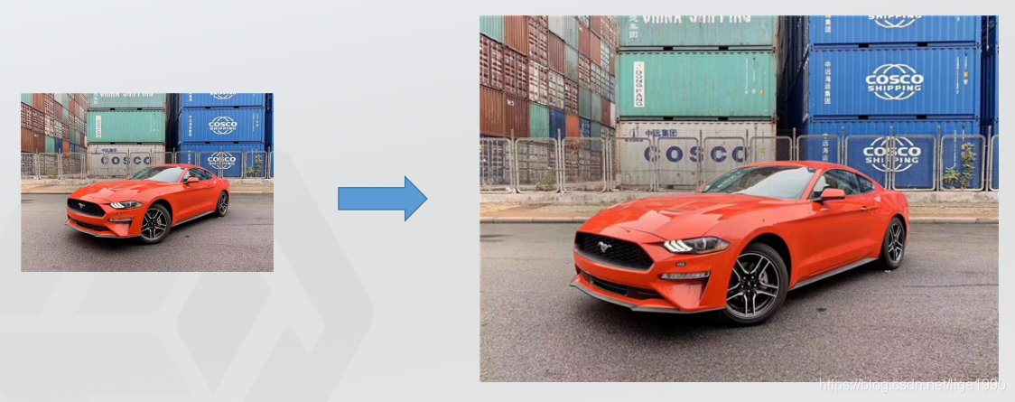
Upsampling

Slide 15
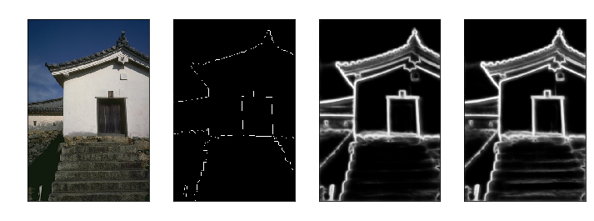
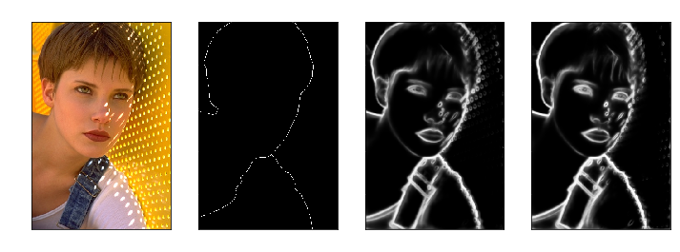
Model Results
Notes:
Top bottom column 3 and 4

Slide 16
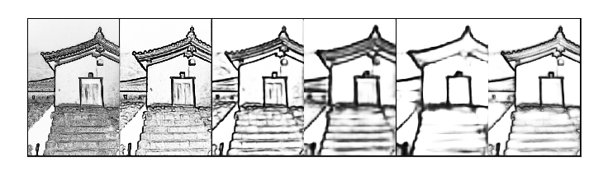
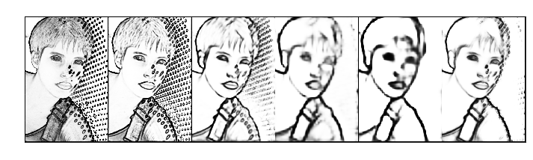
Model Results
Notes:
Examples of actual images, ground truth, model results

Slide 17
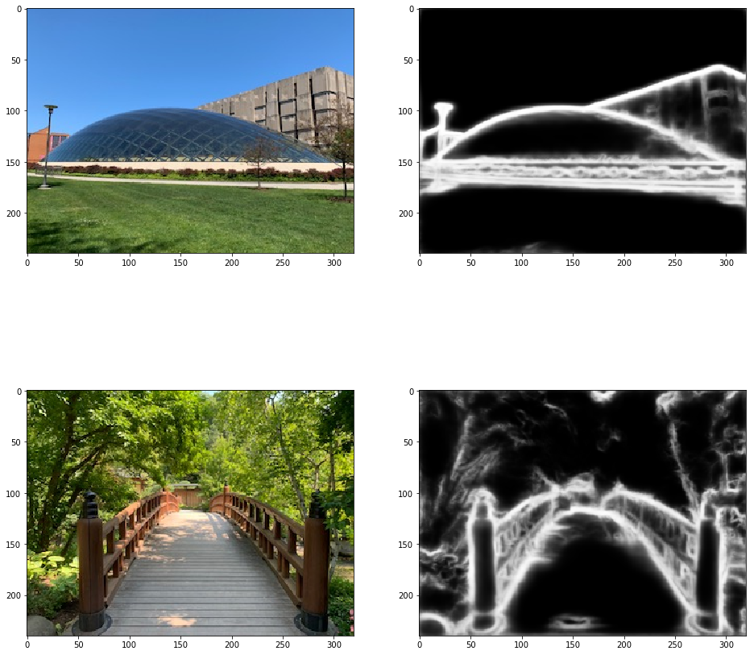
Model Results
Notes:
Examples of actual images, ground truth, model results

Slide 18
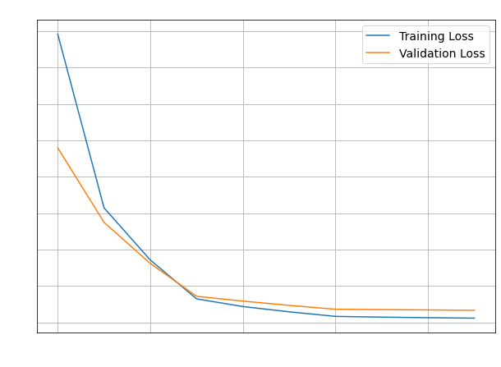
Model Performance
 | ODS | OIS
RCF | 0.757982 | 0.775395
Enhanced RCF | 0.761043 | 0.776080
Notes:
At the beginning underfitting; good balance after epoch 7

Slide 19
Model: Traditional Method Inspired Deep Neural Network for Edge Detection

Slide 20
Model Overview
Inspired from traditional method for edge detection
Better Computational Speed
Feature Extractor
~ User Filters to perform gradient calculations
3x3 CNN Layer x2
Improve performance with respect to noise
Enrichment
~ Enhancement to find larger intensity changes
3x3 CNN Layer with Dilation x5
Capture larger receptive field or a “Global” view
Summarizer
~ Detection to identify points with strong edge
1x1 CNN Layers x8
Summarize and Produce Final Edges
Activation: RELU
Activation: RELU
Activation: Sigmoid
Notes:
Overview of TIN Model
Any diagram showing how it works
Any advantages/challenges?

Slide 21
Model Parameters:
Loss Function:
Weighted Binary Cross-Entropy as edge pixels much fewer than non-edge pixels
Initialization:
Weights: Initialized by Gaussian distribution with mean=0, standard deviation=0.01
Biases: 0
Mini-Batch Size: 1
Learning Rate: 0.01
Epochs: 15
Optimizer: Stochastic Gradient Descent
Training Data Set: 28,800 images
Train split: 80%, Validation split: 20%
Test Data Set: 50 images
Notes:
Design of our Model – Actual different layers we used to process the images

Slide 22

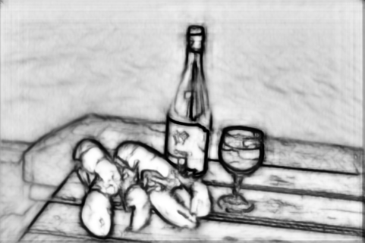
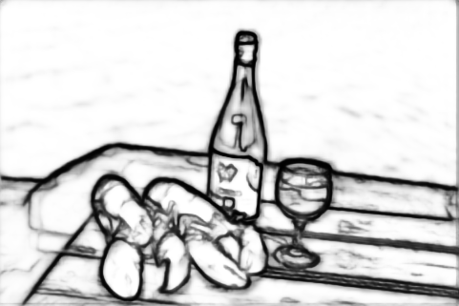
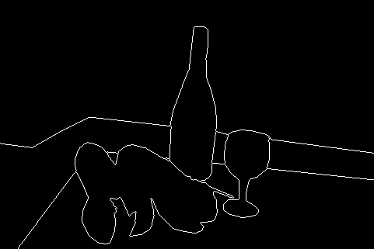
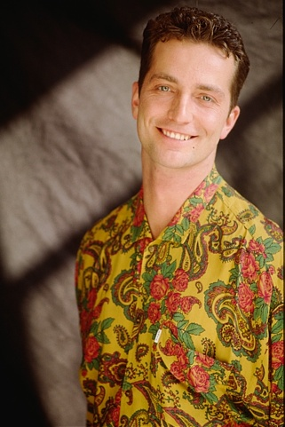
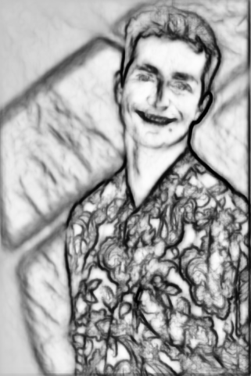
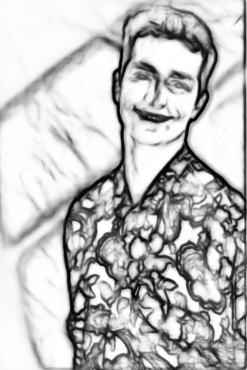
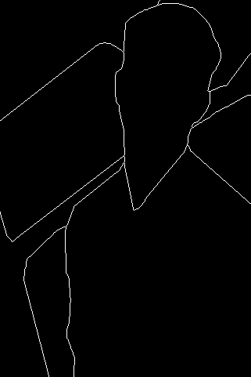
Model Results
Original
Epoch 1
Final
Ground Truth
Notes:
ODS, OIS

Slide 23
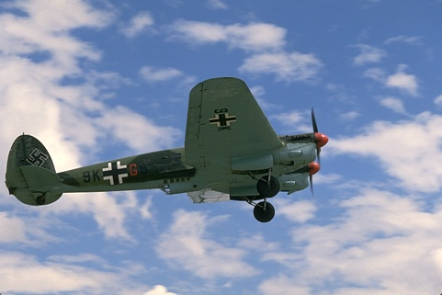
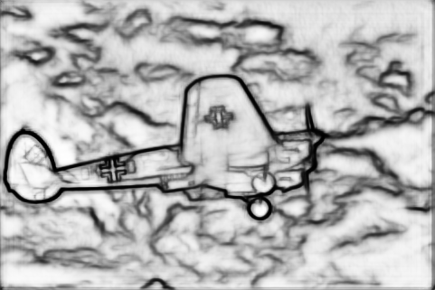
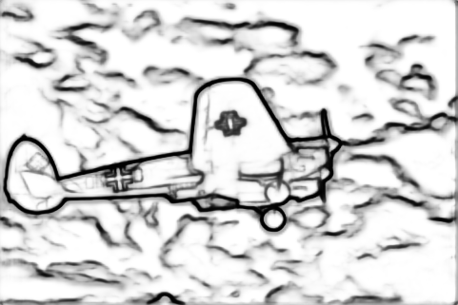
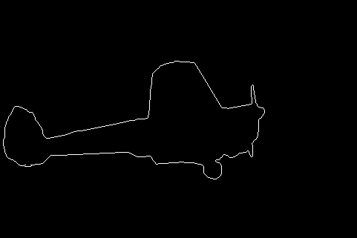
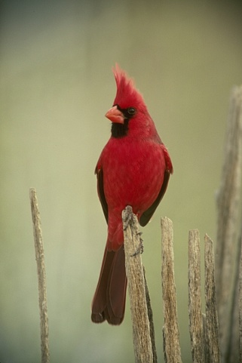
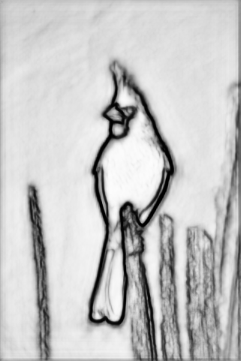
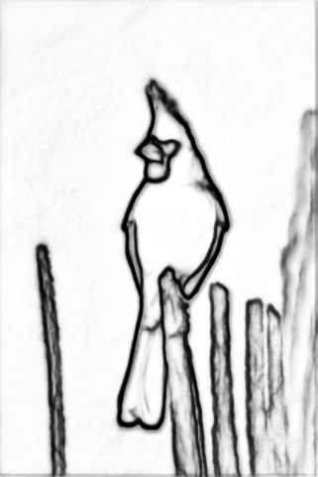
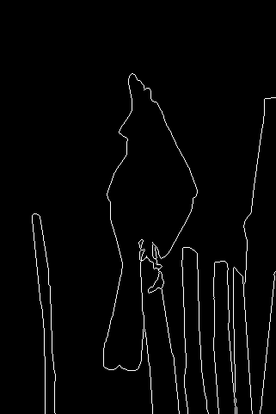
Model Results
Original
Epoch 1
Final
Ground Truth
Notes:
ODS, OIS

Slide 24
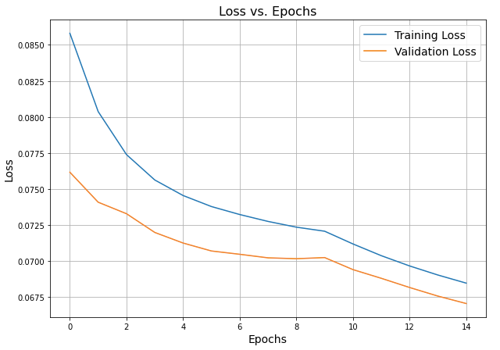
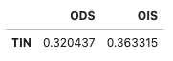
Model Performance
ODS and OIS scores on Test Set
Notes:
Examples of actual images, ground truth, model results

Slide 25
Model Comparison and Recommendations
 | ODS | OIS | Processing time
TIN** | 0.320437 | 0.363315 | 10 hours
RCF | 0.757982 | 0.775395 | 12 hours
Enhanced RCF | 0.761043 | 0.776080 | 13 hours
** TIN model runs partial dataset and less epochs than what it supposes to run given the computer constraint.

Slide 26
Lessons Learned
Edge detection is a computer intensive work so knowing how to implement GPUs in distributed system is critical for large scale work. In this project, we utilize resources from Research Computing Center and Paperspace.
The regularization techniques do not work well for edge detection as performance will deteriorate when applying those
Augmentation plays a key role for the model performance. When not including augmented training sets, our model performance (loss, OIS, ODS) drops significantly
As edge detection is quite subjective, this will benefit from enriching ground truth datasets. Some of the commonly used datasets are BSDS500 and NYUD. However, ground truth can be continued to improve using semi-supervised learning.
Notes:
Design of our Model – Actual different layers we used to process the images

Slide 27
Future Work
Look for methods to reduce computational complexity
Non-Maximal Suppression on final outputs
Try a different dataset
Try Bicubic interpolation instead Bilinear interpolation in RCF
Include additional stages
Tune other global parameters
Improve enrichment process in TIN
Experiment with different filters used in traditional methods such as LoG etc
Improve ground truth images using an iterative learning approach
Notes:
Design of our Model – Actual different layers we used to process the images

Slide 28
References
Y. Liu, M.-M. Cheng, X. Hu, K. Wang, and X. Bai, “Richer convolutional features for edge detection,” in IEEE Conf. Comput. Vis. Pattern Recog., 2017, pp. 5872–5881.
J. K. Wibisono and H. -M. Hang, "Traditional Method Inspired Deep Neural Network For Edge Detection," 2020 IEEE International Conference on Image Processing (ICIP), 2020, pp. 678-682, doi: 10.1109/ICIP40778.2020.9190982.
https://github.com/balajiselvaraj1601/RCF_Pytorch_Updated
https://github.com/Walstruzz/edge_eval_python
https://www.cse.usf.edu/~r1k/MachineVisionBook/MachineVision.files/MachineVision_Chapter5.pdf
https://github.com/jannctu/TIN
Notes:
Future work with edge detection

Slide 29
Thank You

Slide 30
Appendix

Slide 31
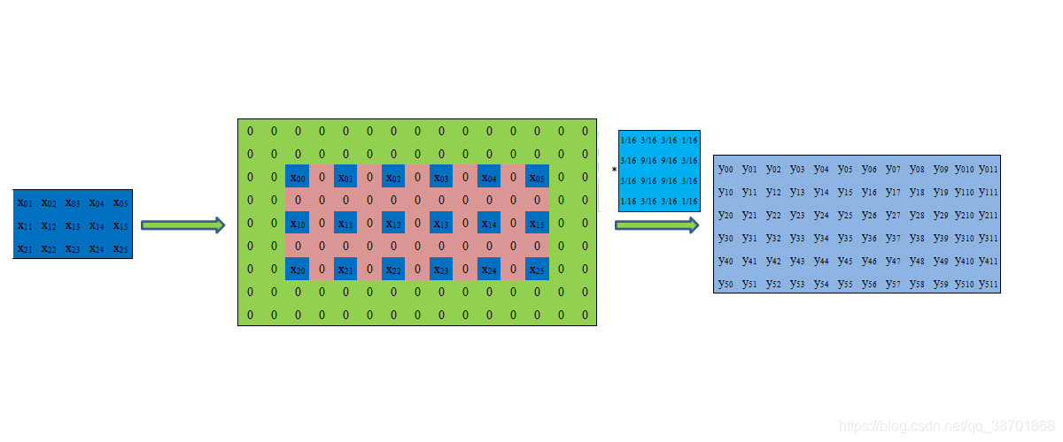
Upsampling
Notes:
Bilinear interpolation is a method of constructing new data points within the range of a discrete set of known data points. Image interpolation refers to the“guess”of intensity values at missing locations.

